Slide 1

IT Engineering Department
Finolex Academy of Management and Technology
UNIVERSITY OF MUMBAI
Academic Year
2023-2024

Slide 2
A Project Presentation on
‘GAMING BOX’
By
Aditi Srivastava Srushti Rane
Maithili Yadav
Soniya Raorane Under the Guidance of
Prof. Onkar Dike Sir

Slide 3
TABLE OF CONTENTS
1. Problem statement
2. Objectives
3. Literature Survey
4. Proposed System
5. UML Diagrams
6. Implementation
7. Results
8. References

Slide 4
PROBLEM STATEMENT
Web-based games use web technologies like HTML, CSS, and JavaScript to run in a web browser. Some web-based games can be played offline, but most require an internet connection. Web-based games are becoming more popular as the technology to create them improves. HTML5, CSS3, and JavaScript are all web technologies that allow for more complex games to be created.
To implement nostalgic and fun environmental game using web development.
Many of the people have many problems and they came home with tiredness. In order to get relieved from that tiredness they want to play games. For such people we have designed this game. Different Colors gives them joy so they wants to play mostly spiderman game which are having color full environment.

Slide 5
OBJECTIVES
The project’s goal is to Give a Free enjoyment and stress free life so that Any player don’t have to waste time on Download the game then run it.
Making animations of the characters designed such as attack animation, death animation, etc.
Designing the level of the gameplay by placing the characters along with their animations.
Our Mini figure spiderman game will help in making an easier, hassle-free and enjoyable experience game for all the people.

Slide 6
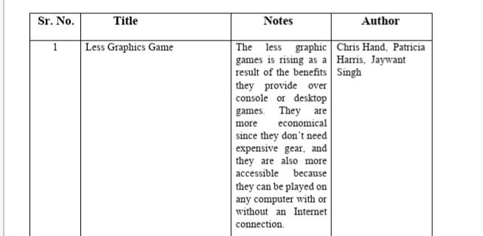
LITERATURE SURVEY

Slide 7
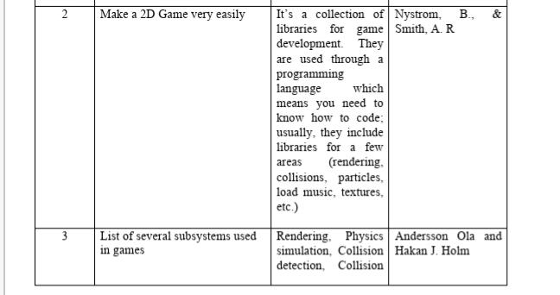

Slide 8
PROPOSED SYSTEM
The proposed system for a web based game using HTML CSS and JavaScript would include the following features:
-A game engine written in JavaScript that would handle the game logic and rendering.
-A CSS file that would control the look and feel of the game.
-A HTML file that would act as the skeleton for the game, including the canvas element where the game would be rendered.
-JavaScript libraries such as jQuery and underscore.js would be used to provide additional functionality.
-The game would be hosted on a web server, accessible to anyone with an internet connection.

Slide 9
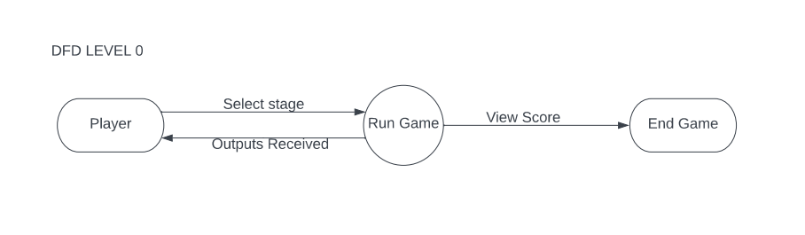
UML Diagrams
DFD
Level “0”

Slide 10
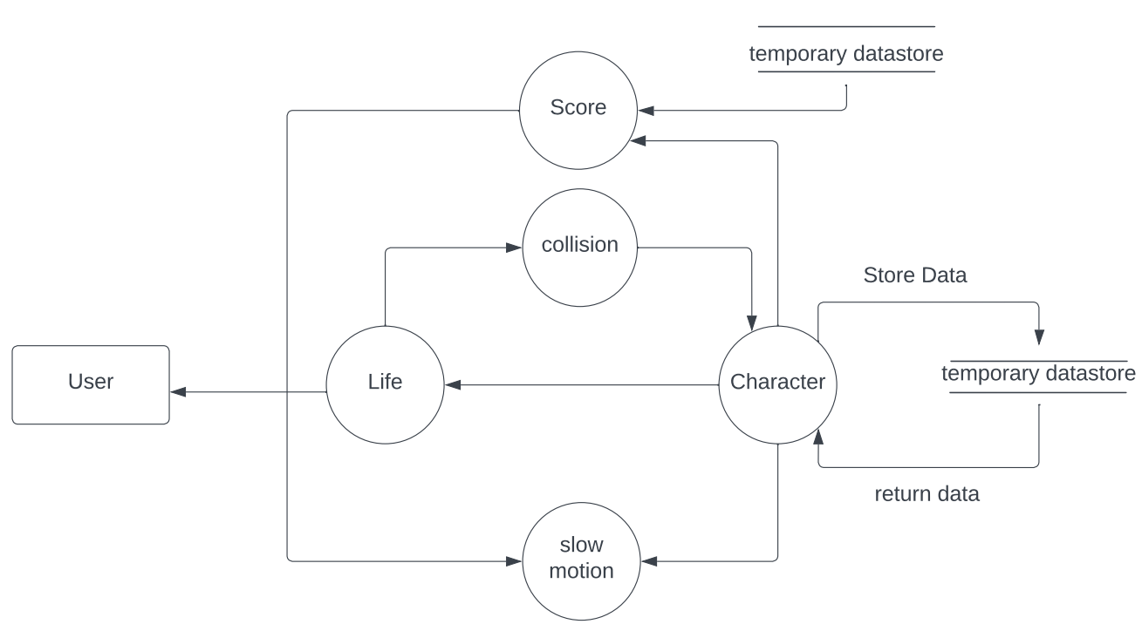
DFD Level “1”

Slide 11
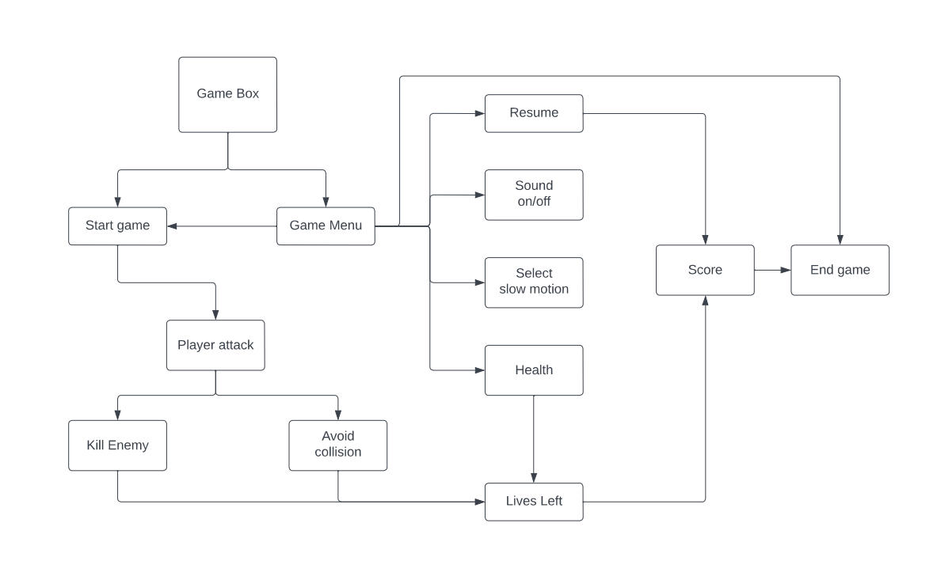
Architecture Diagram

Slide 12
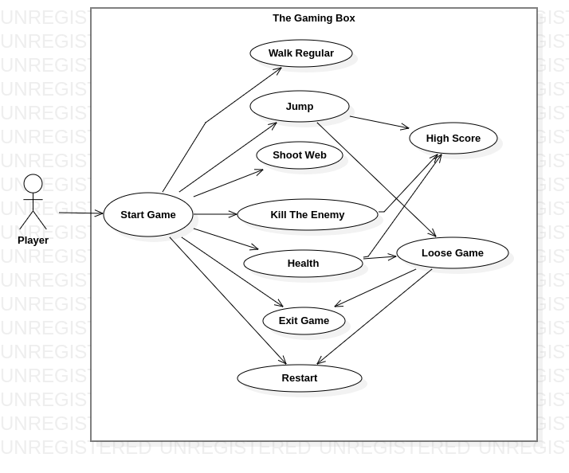
Use Case Diagram

Slide 13
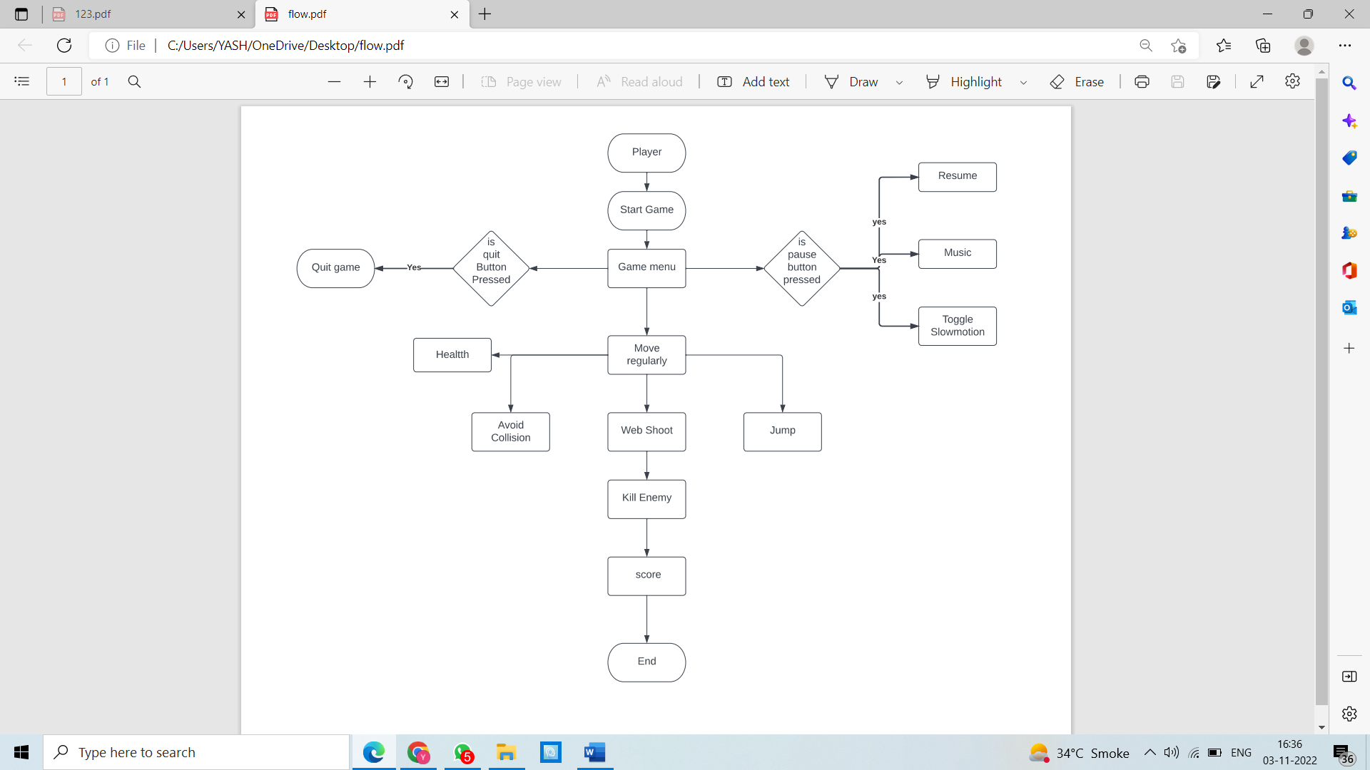
Flow Chart
Notes:
Sequence Diagram

Slide 14
Technology Stack
● SOFTWARE REQUIRMENT
HTML
CSS
JavaScript
● HARDWARE REQUIRMENT
CPU-AMD Ryzen™ 7 4800H Mobile Processor, Intel i3- 10th generation
STORAGE-8GB DDR5-4800,SO-DIMM x 2 slot
512GB M.2 NVMe™ PCIe® 4.0 SSD
Notes:
Class Diagram

Slide 15
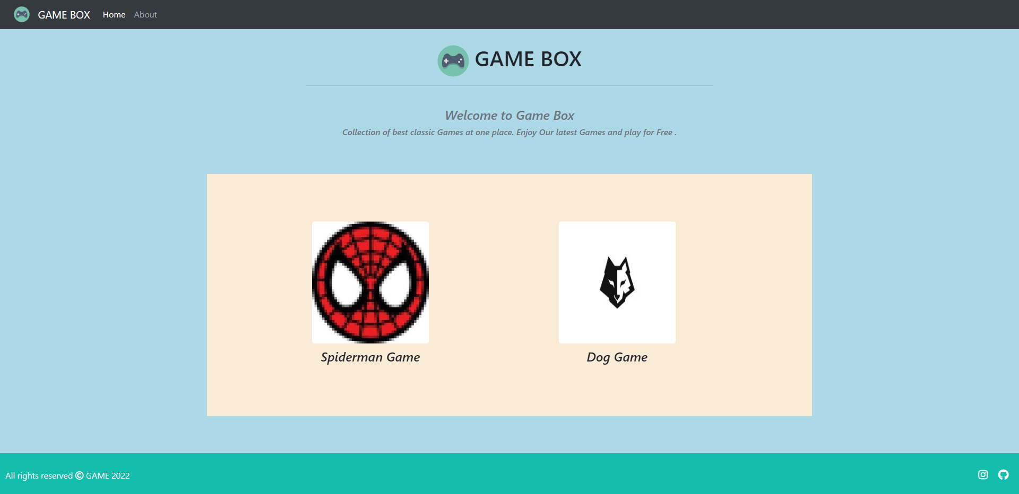
Implementation

Slide 16
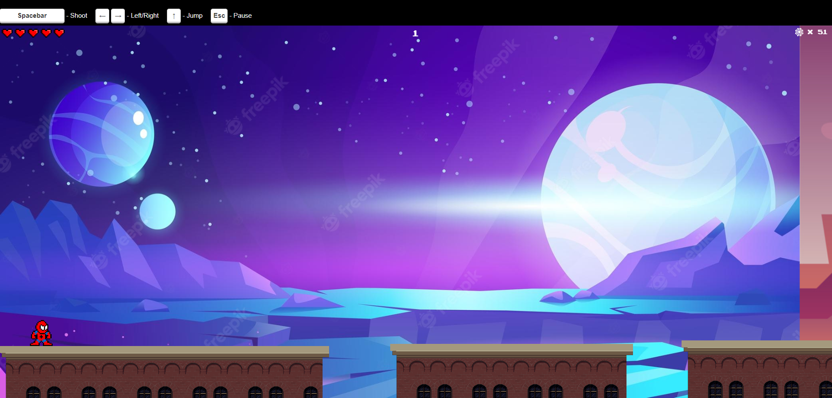

Slide 17
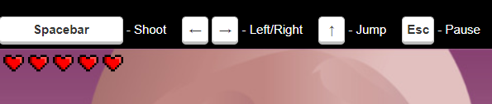

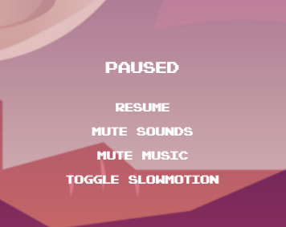

HEALTHBAR
WEB
SHOOTER
GAME MENU
GAME
SCORE

Slide 18
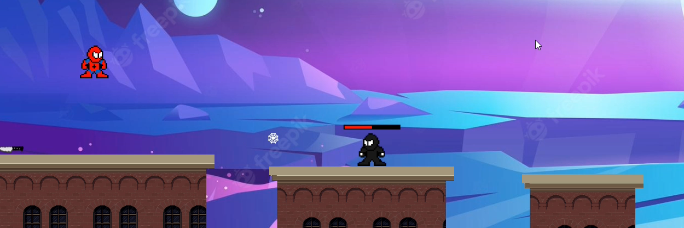
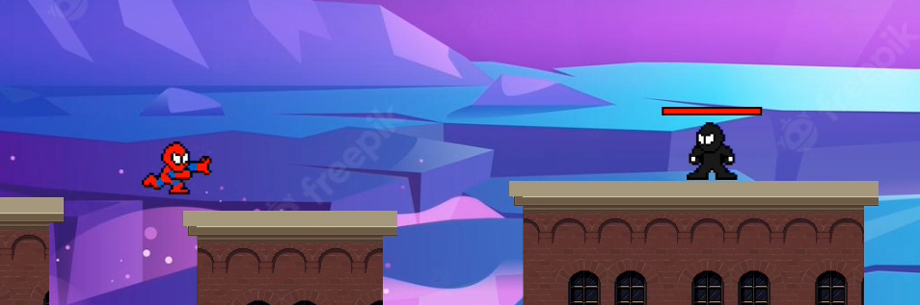

Slide 19
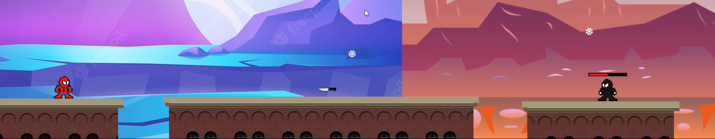
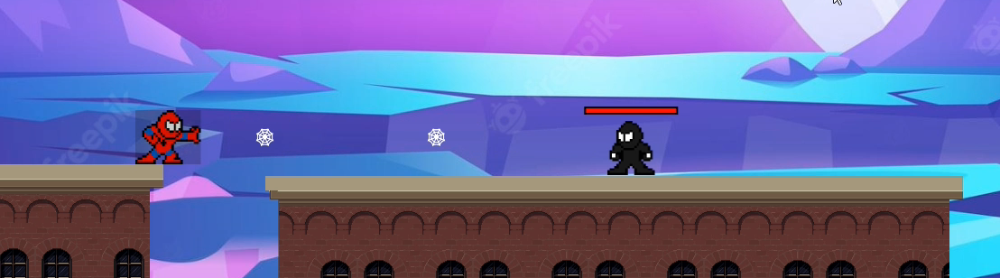

Slide 20
REFERENCE
◆ Modeling player experience in Super Mario Bros
https://www.researchgate.net/publication/224603701_Modeling_player_experience_in_Super_Mario_Bros
◆ Game Design Research
https://www.researchgate.net/publication/282185969_Game_Design_Research
◆ Dinosaur Game
https://codepen.io/MysticReborn/pen/rygqao

Slide 21
THANK YOU!!

